Slide 1
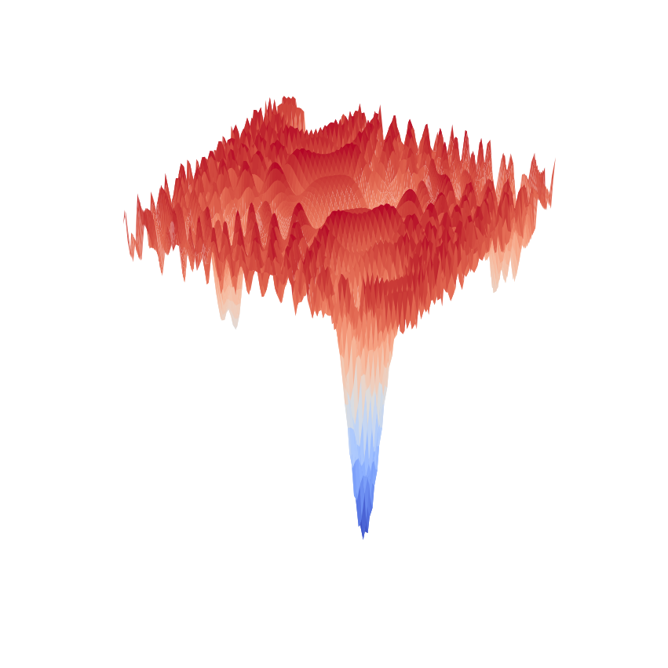


Bayesianism, Convexity, and the quest towards Optimal Algorithms
Boaz Barak
Harvard University
Microsoft Research
Partially based on work in progress with Sam Hopkins,
Jon Kelner, Pravesh Kothari, Ankur Moitra and Aaron Potechin.

Slide 2
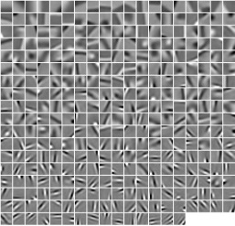
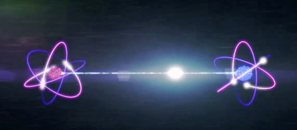
Talk Plan
Dubious historical analogy.
Philosophize about automating algorithms.
Wave hands about convexity and the Sum of Squares algorithm.
Sudden shift to Bayesianism vs Frequentism.
Work in progress on the planted clique problem.
Skipping today:
Sparse coding / dictionary learning / tensor completion
[B-Kelner-Steurer’14,’15 B-Moitra’15]
Unique games conjecture / small set expansion
[..B-Brandao-Harrow-Kelner-Steurer-Zhou’12..]
Connections to quantum information theory

Slide 3
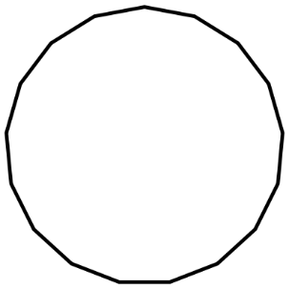
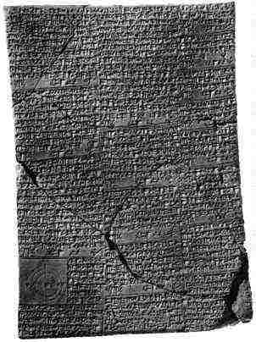
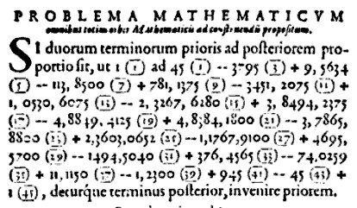

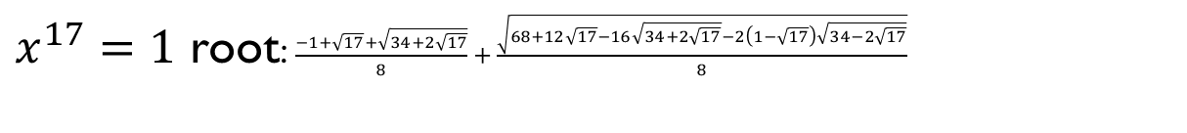

Prologue: Solving equations
Babylonians (~2000BC):
Solutions for quadratic equations.
del Ferro-Tartaglia-Cardano-Ferrari (1500’s):
Solutions for cubics and quartics.
van Roomen/Viete (1593):
“Challenge all mathematicians in the world”
$$x^{45}−45x^{43}+…+45x=\sqrt{7/4+…\sqrt{45/64}}$$
Euler(1740’s):
Special cases of quintics
Vandermonde(1777):
Solve $x^{11}=1$ with square and fifth roots
Gauss (1796):
$x^{17}=1$ root: $\frac{−1+\sqrt{17}+\sqrt{34+2\sqrt{17}}}{8}+\frac{\sqrt{68+12\sqrt{17}−16\sqrt{34+2\sqrt{17}}−2\left(1−\sqrt{17}\right)\sqrt{34−2\sqrt{17}}}}{8}$
…
Ruffini-Abel-Galois (early 1800’s):
Some equations can’t be solved in radicals
Characterization of solvable equations.
Birth of group theory
17-gon construction now “boring”:
few lines of Mathematica.

Slide 4
A prototypical TCS paper
Interesting problem
Efficient Algorithm
(e.g. MAX-FLOW in P)
Hardness Reduction
(e.g. MAX-CUT NP-hard)
Can we make algorithms boring?
Can we reduce creativity in algorithm design?
Can we characterize the “easy” problems?

Slide 5
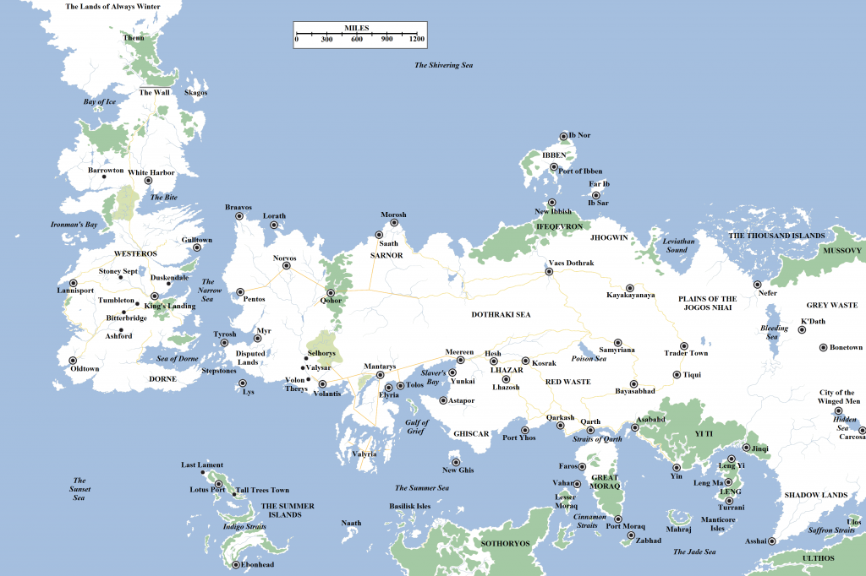
A prototypical TCS paper
Algorithmica
Interesting problem
Intractabilia
Efficient Algorithm
(e.g. MAX-FLOW in P)
Hardness Reduction
(e.g. MAX-CUT NP-hard)
Can we make algorithms boring?
Can we reduce creativity in algorithm design?
Can we characterize the “easy” problems?
Notes:
=

Slide 6
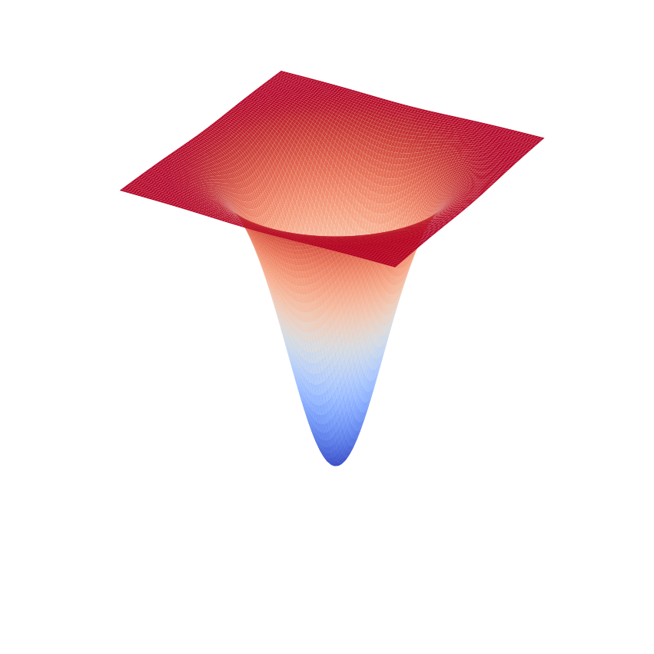
Theme: Convexity
Algorithmica
Intractabilia
Notes:
=

Slide 7


Convexity in optimization
Interesting Problem
Convex
Problem
General Solver
Creativity!!
☹
Example: Can embed $\{±1\}$ in $[−1,+1]$ or $\{x:∥x∥=1\}$ [Geomans-Williamson’94]

Slide 8
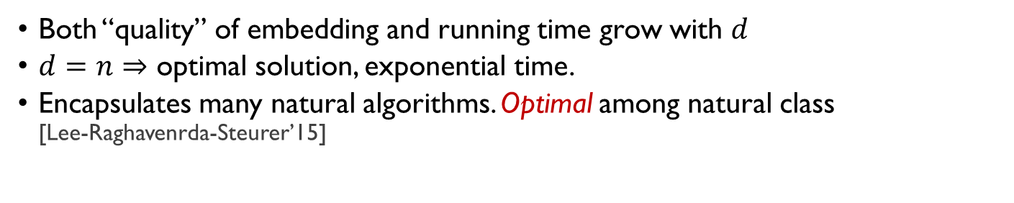


Convexity in optimization
Interesting Problem
Convex
Problem
General Solver
Creativity!!
☹
Sum of Squares Algorithm: [Shor’87,Parrilo’00,Lasserre’01]
Universal embedding of any* optimization problem into an
$n^{d}$-dimensional convex set.
Algorithmic version of works related to Hilbert’s 17th problem
[Artin 27,Krivine64,Stengle74]
Both “quality” of embedding and running time grow with $d$
$d=n$ $⇒$ optimal solution, exponential time.
Encapsulates many natural algorithms. Optimal among natural class
[Lee-Raghavenrda-Steurer’15]
Hope*: Problem easy iff embeddable with small $d$

Slide 9

Talk Plan
Dubious historical analogy.
Philosophize about automating algorithms.
Wave hands about convexity and the Sum of Squares algorithm.
Sudden shift to Bayesianism vs Frequentism.
Non-results on the planted clique problem.

Slide 10
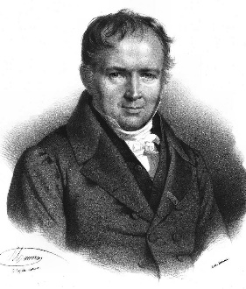
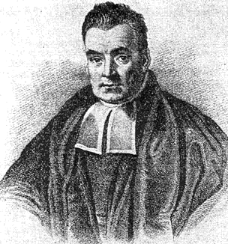


Frequentists vs Bayesians
“There is 10% chance that the ${10}^{20}th$ digit of $π$ is 7”
“Nonsense! The digit is either 7 or isn’t.”
“I will take an $11:1$ bet on this.”

Slide 11
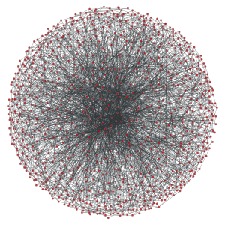

Planted Clique Problem
[Karp’76,Kucera’95]
Distinguish between $G_{n,1/2}$ and $G_{n,1/2}+$ $k$-clique
Central problem in average-case complexity:
Cryptography [Juels’02,Applebaum-B-Wigderson’10]
Motifs in biological networks [Milo et al Science’02, Lotem et al PNAS’04,..]
Sparse principal component analysis [Berthet-Rigollet’12]
Nash equilibrium [Hazan-Krauthgamer’09]
Certifying Restricted isometry property [Koiran-Zouzias’12]
No poly time algorithm known when $k≪\sqrt{n}$
Image credit: Andrea Montanari

Slide 12

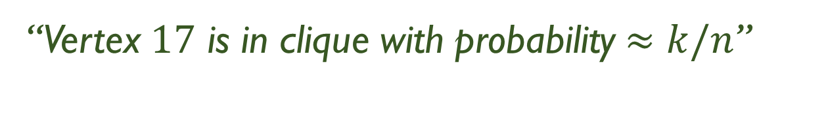
Planted Clique Problem
[Karp’76,Kucera’95]
Distinguish between $G_{n,1/2}$ and $G_{n,1/2}+$ $k$-clique
“Vertex $17$ is in clique with probability $≈k/n$”
“Nonsense! The probability is either $0$ or $1$.”

Slide 13
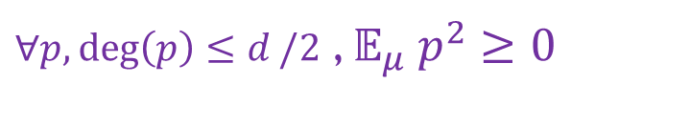

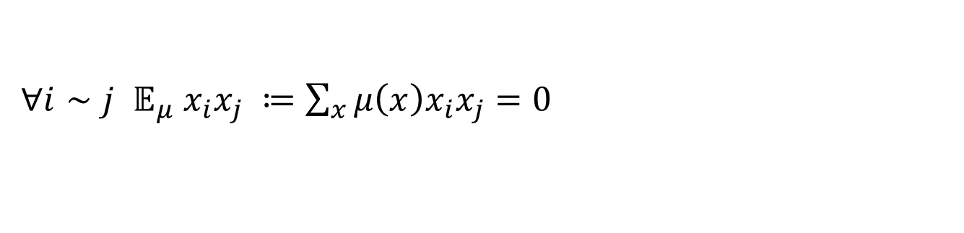
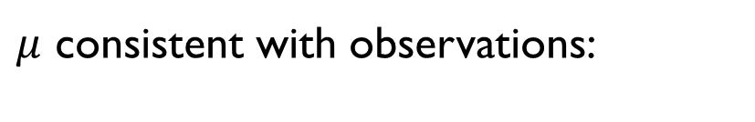

Making this formal
Distinguish between $G_{n,1/2}$ and $G_{n,1/2}+$ $k$-clique
Computational
degree $d$ pseudo-distribution
Classical Bayesian Uncertainty: posterior distribution
$$μ:{\left\{0,1\right\}}^{n}→ℝ , ∀x,μ\left(x\right)≥0 , \sum_{x}{μ\left(x\right)}=1$$
$∀p,\deg\left(p\right)≤d/2$ , $𝔼_{μ} p^{2}≥0$
$μ$ consistent with observations:
${∀i∼j 𝔼}_{μ} x_{i}x_{j} ≔\sum_{x}{μ\left(x\right)x_{i}x_{j}}=0$

Slide 14
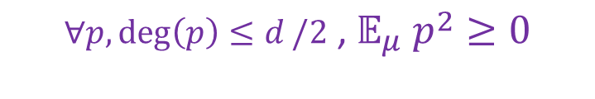
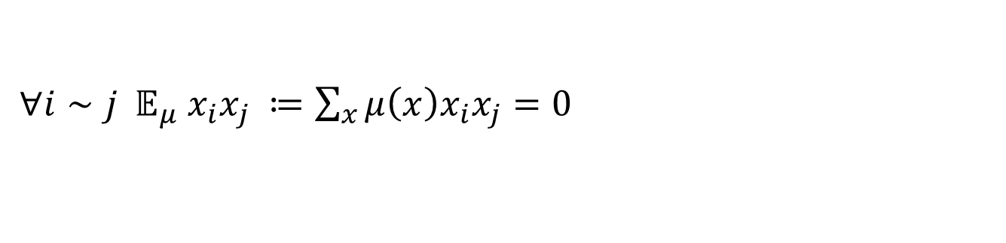
Making this formal
Distinguish between $G_{n,1/2}$ and $G_{n,1/2}+$ $k$-clique
Computational
degree $d$ pseudo-distribution
Classical Bayesian Uncertainty: posterior distribution
$$μ:{\left\{0,1\right\}}^{n}→ℝ , ∀x,μ\left(x\right)≥0 , \sum_{x}{μ\left(x\right)}=1$$
$$∀p,\deg\left(p\right)≤d/2\text{ , }𝔼_{μ} p^{2}≥0$$
$μ$ consistent with observations:
${∀i∼j 𝔼}_{μ} x_{i}x_{j} ≔\sum_{x}{μ\left(x\right)x_{i}x_{j}}=0$

Slide 15


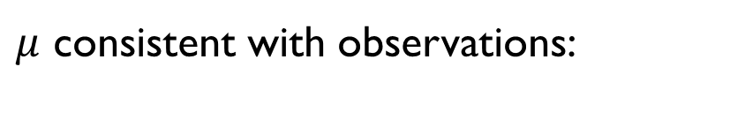
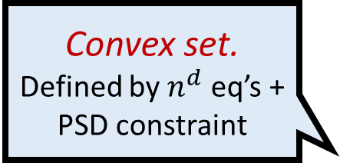



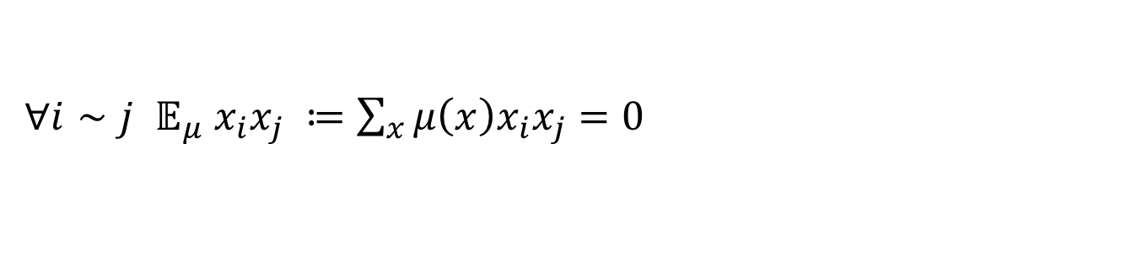


Making this formal
Convex set.
Defined by $n^{d}$ eq’s + PSD constraint
Computational
degree $d$ pseudo-distribution
Classical Bayesian Uncertainty: posterior distribution
$$μ:{\left\{0,1\right\}}^{n}→ℝ , ∀x,μ\left(x\right)≥0 , \sum_{x}{μ\left(x\right)}=1$$
$$∀p,\deg\left(p\right)≤d/2\text{ , }𝔼_{μ} p^{2}≥0$$
$μ$ consistent with observations:
${∀i∼j 𝔼}_{μ} x_{i}x_{j} ≔\sum_{x}{μ\left(x\right)x_{i}x_{j}}=0$
“Vertex $17$ is in clique with probability $𝔼_{μ}x_{17}$”
Definition*:
$$SOS_{d}\left(G\right)=\max_{μ:d−p.dist}{𝔼_{μ}∑x_{i}}$$
Corollary: $SOS_{d}\left(G\right)≥ω(G)$ for all $d$
Open Question: Is $SOS_{d}\left(G\right)≪\sqrt{n}$ for some $d=O\left(1\right)$?

Slide 16
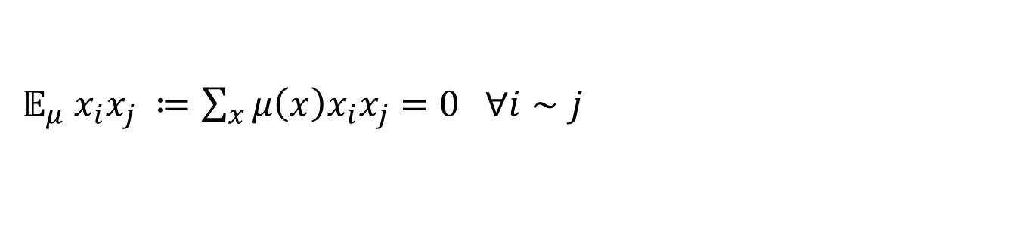
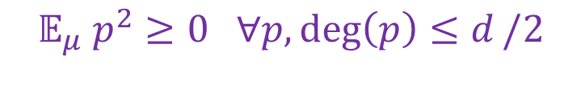
Making this formal
Convex set.
Defined by $n^{d}$ eq’s + PSD constraint
Computational
degree $d$ pseudo-distribution
Classical Bayesian Uncertainty: posterior distribution
$$μ:{\left\{0,1\right\}}^{n}→ℝ , ∀x,μ\left(x\right)≥0 , \sum_{x}{μ\left(x\right)}=1$$
$$𝔼_{μ} p^{2}≥0 ∀p,\deg\left(p\right)≤d/2$$
$μ$ consistent with observations:
$𝔼_{μ} x_{i}x_{j} ≔\sum_{x}{μ\left(x\right)x_{i}x_{j}}=0 ∀i∼j$
“Vertex $17$ is in clique with probability $𝔼_{μ}x_{17}$”
Definition*:
$$SOS_{d}\left(G\right)=\max_{μ:d−p.dist}{𝔼_{μ}∑x_{i}}$$
Corollary: $SOS_{d}\left(G\right)≥ω(G)$ for all $d$
Open Question: Is $SOS_{d}\left(G\right)≪\sqrt{n}$ for some $d=O\left(1\right)$?

Slide 17



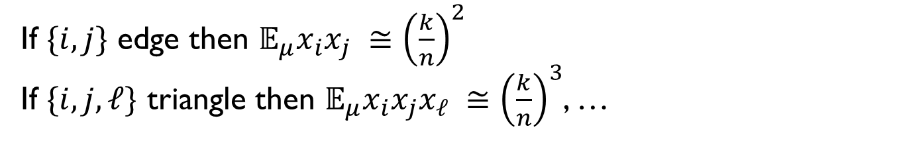
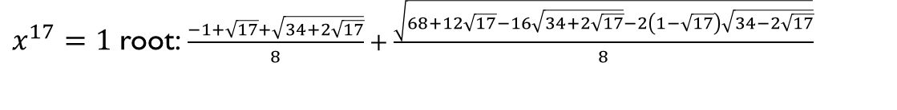
Open Question: Is $SOS_{d}\left(G\right)≪\sqrt{n}$ for some $d=O\left(1\right)$?
“Theorem” [Meka-Wigderson’13]: $G∼G_{n,1/2} ,SOS_{d}\left(G\right)≅\sqrt{n}$
“Proof”: Let $k=δ\sqrt{n}$ and define $μ$ of “maximal ignorance”:
If $\{i,j\}$ edge then $𝔼_{μ}x_{i}x_{j} ≅{\left(\frac{k}{n}\right)}^{2}$
If $\{i,j,ℓ\}$ triangle then $𝔼_{μ}x_{i}x_{j}x_{ℓ} ≅{\left(\frac{k}{n}\right)}^{3}$, …
$μ$ is valid p-dist assuming higher degree Matrix-valued Chernoff bound
Bug [Pisier]: Concentration bound is false.
In fact, for $k>n^{1/3}$, $∃p$ deg 2 s.t. $𝔼_{μ}p^{2}<0$ [Kelner]
Maximal ignorance moments are OK for $k∼n^{1/\left(0.5d+1\right)}$
[Meka-Potechin-Wigderson’15, Desphande-Montanari’15, Hopkins-Kothari-Potechin’15 ]

Slide 18
MW’s “conceptual” error
Pseudo-distributions should be as simple as possible but not simpler.
Following A. Einstein.
Pseudo-distributions should have maximum entropy but respect the data.

Slide 19
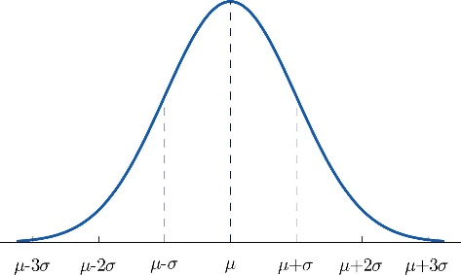
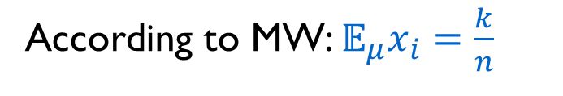

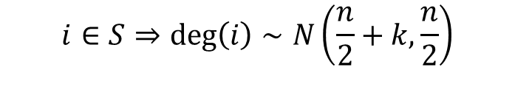
MW violated Bayeisan reasoning:
Consider $𝔼_{μ}x_{i}=\operatorname{Pr}{[i in clique]}$ , $\deg{(i)}=\frac{n}{2}+Δ$ , $\left|Δ\right|=Θ(\sqrt{n})$
According to MW: $𝔼_{μ}x_{i}=\frac{k}{n}$
Pseudo-distributions should have maximum entropy but respect the data.
By Bayesian reasoning:
$$i∉S⇒\deg\left(i\right)∼N\left(\frac{n}{2},\frac{n}{2}\right)$$
$$i∈S⇒\deg\left(i\right)∼N\left(\frac{n}{2}+k,\frac{n}{2}\right)$$
$𝔼_{μ}x_{i}$ should be reweighed by $\exp\left(−\frac{{2\left(Δ−k\right)}^{2}}{n}\right)/\exp\left(−\frac{2Δ^{2}}{n}\right)∝\exp{(\frac{4kΔ}{n})}$

Slide 20
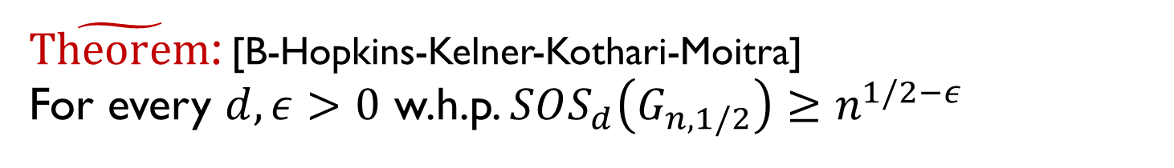
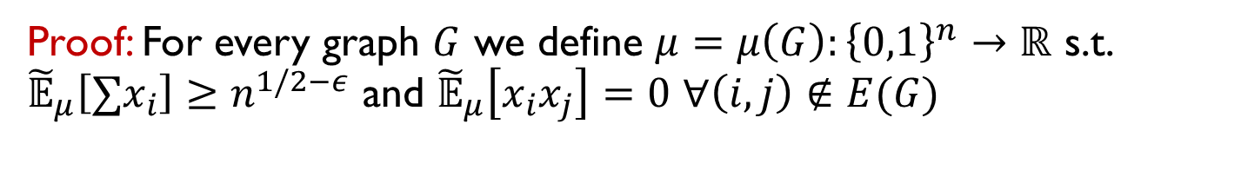
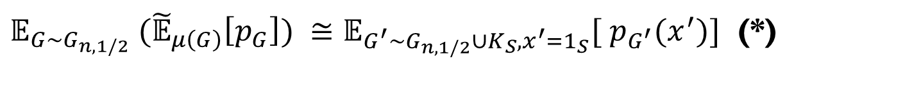
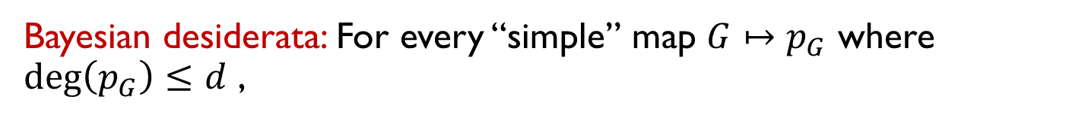
Going Bayesian
$\tilde{Theorem}$: [B-Hopkins-Kelner-Kothari-Moitra]
For every $d,ε>0$ w.h.p. $SOS_{d}\left(G_{n,1/2}\right)≥n^{1/2−ε}$
$d=4$ case recently shown by [Hopkins-Kothari-Potechin-Raghavendra-Schramm’16]
Proof: For every graph $G$ we define $μ=μ\left(G\right):{\left\{0,1\right\}}^{n}→ℝ$ s.t. ${\tilde{𝔼}}_{μ}\left[∑x_{i}\right]≥n^{1/2−ε}$ and ${\tilde{𝔼}}_{μ}\left[x_{i}x_{j}\right]=0$ $∀\left(i,j\right)∉E(G)$
Bayesian desiderata: For every “simple” map $G↦p_{G}$ where $\deg\left(p_{G}\right)≤d$ ,
$𝔼_{G∼G_{n,1/2}} ({\tilde{𝔼}}_{μ\left(G\right)}\left[p_{G}\right]) ≅𝔼_{G^{′}∼G_{n,1/2}∪K_{S},x^{′}=1_{S}}[ p_{G^{′}}(x^{′})]$ (*)
Crucial observation: If “simple” is low degree then this essentially* determines the moments – no creativity needed!!

Slide 21
Why is this interesting?
Shows SoS captures Bayesian reasoning in a way that other algorithms do not.
Suggests new way to define what a computationally bounded observer knows about some quantity..
..and a more principled way to design algorithms based on such knowledge. (see [B-Kelner-Steurer’14,’15])
Even if SoS is not the optimal algorithm we’re looking for, the dream of a more general theory of hardness, easiness and knowledge is worth pursuing.

Slide 22
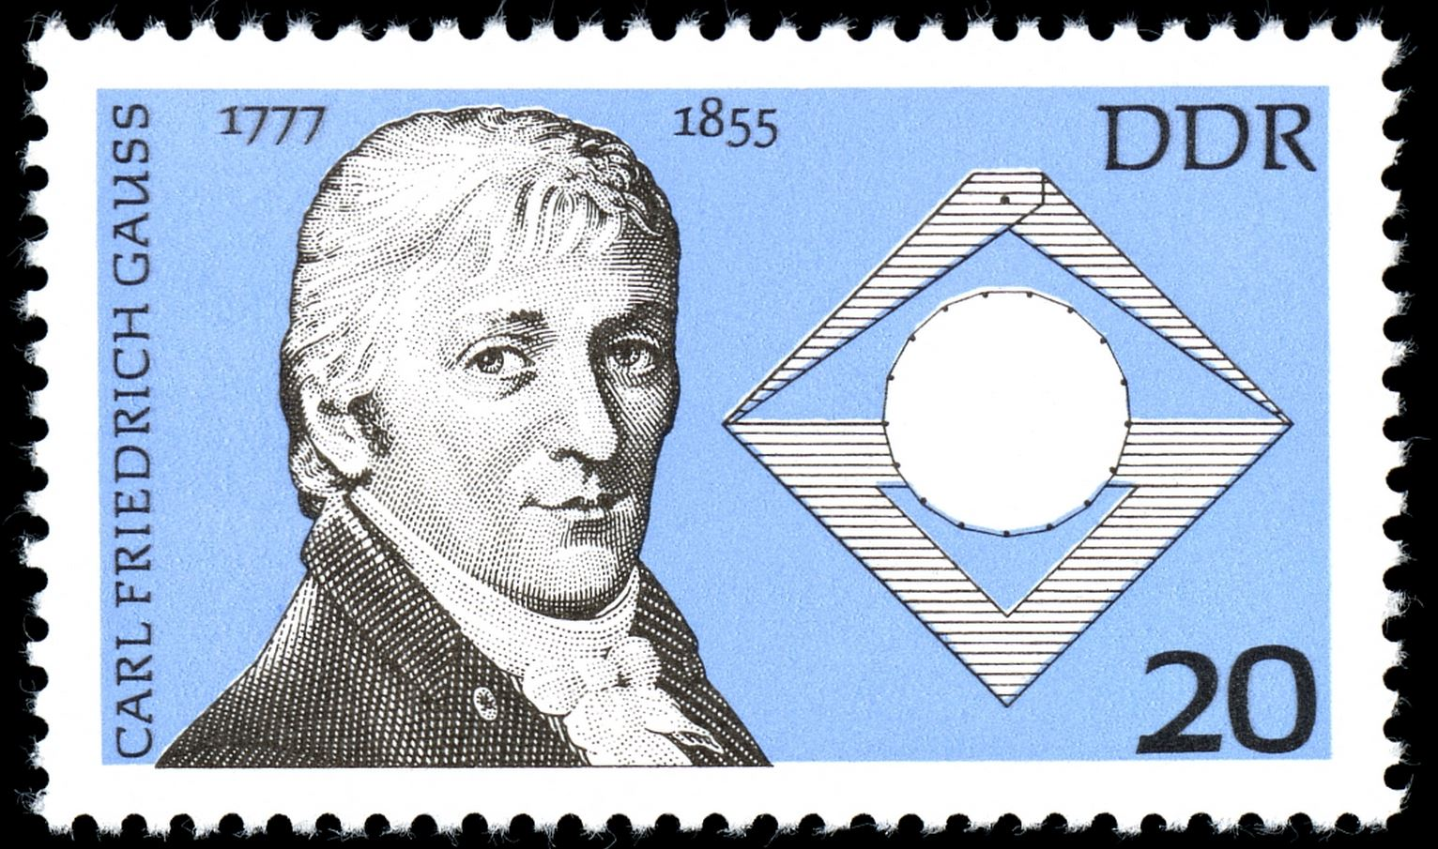
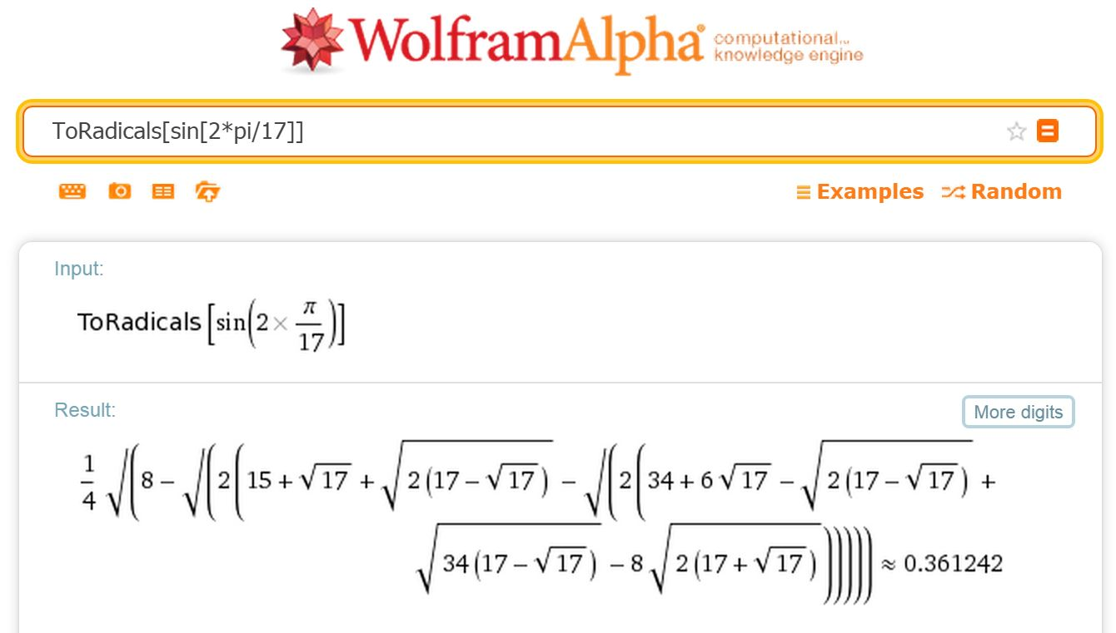
Why is this interesting?
Thanks!!
Shows SoS captures Bayesian reasoning in a way that other algorithms do not.
Algorithmica
Intractabilia
Suggests new way to define what a computationally bounded observer knows about some quantity..
..and a more principled way to design algorithms based on such knowledge. (see [B-Kelner-Steurer’14,’15])
Even if SoS is not the optimal algorithm we’re looking for, the dream of a more general theory of hardness, easiness and knowledge is worth pursuing.

